Slide 1
Sales Data Analysis using Excel
STUDENT NAME:Sathish Kumar P
REGISTER NO: 312219983(asunm1719223276)
DEPARTMENT:BCOM COMPUTER APPLICATION
COLLEGE: PERI COLLEGE OF ARTS & SCIENCE

Slide 2
ANALYSIS TITLE
Sales Analysis On SK FASTFOOD using Excel

Slide 3


AGENDA
Problem Statement
Project Overview
End Users
Our Solution and Proposition
Dataset Description
Modelling Approach
Results and Discussion
Conclusion
3/21/2024 Annual Review

Slide 4

PROBLEM STATEMENT
DUE TO HEAVY SALES THEY ARE UNABLE TO TRACK
WHICH MANAGER DID MOST SALE ?
WHICH FOOD TIME HAD MOST NUMBER OF SALES ?
BY WHICHFOOD CATEGORY THEY EARNED MORE ?
HOW MUCH REVENUE GENERATED ?

Slide 5

ANALYSIS OVERVIEW
THERE IS BRIEF ANLAYSIS OF HOW SALES HAPPENIG ,BY WHOM IT’S BEEN HAPPING,WHICH TIME,FOOD PRODUCT AND HOW IT’S BEING REGULATED AND THEIR MOST GENERAL POSTION ON IT.

Slide 6

WHO ARE THE END USERS?
THE END USERS ARE ABSOULTLEY THE BUSINESS OWNER , HENCE THE DATA HERE GENERATED IS RELATED TO THE FINANCIAL POSTION AND THE MONETRY STATUS OF THE BUSINESS AND THEIR ANALYSIS TOO.

Slide 7

OUR SOLUTION AND ITS VALUE PROPOSITION
WE HAD REVIWED THEIR DATA INCH BY INCH.
PERCISELY ORDED THEM INTO THE FORMAT.
CLEARLY ANALYSIED THEM.
ORDERED THEM IN A PRORPER MANNER WITH ALONG ANS AMONGST DESCRIPTIONS.
VALUED THEIR THE POSTION AND THEIR STATUS IN THEIR BUSINESS.
FUULY ANLAYSIED THEIR GIVEN DATA AND VISUALIZING IN A PRESENTABLE MANNER.

Slide 8
Dataset Description
ORDER ID
DATE
ITEM NAME
ITEM TYPE
PRICE
QUANTITY
AMOUNT
TRANSACTION BY
MANAGER
TIME OF SALES

Slide 9

THE "WOW" IN OUR SOLUTION
WE USED ,
TABLE
SUMMARIZED THEM.
USED PIVOT TABLE FOR VALUES.
GRAPHS LIKE PIECHART,LINE AND BAR.
3/21/2024 Annual Review
‹#›

Slide 10
1. DATA MINNING : THERE IS SO MANY DATA TO WE CAN SCROLL ON SO FIRST GO THROUGH AND GRASP THE CONTENT IT TO FURTHER PROCESS. 2 . FINDING DUPLICATE : IT IS THE MOST PRIMARY AND NECESSARY PROCESS FOR VALIDATION. 3 . FILTERATION : WE ALTERDED AND FILTERED DATA FOR PRECISNESS AND ACCURACY.
MODELLING
‹#›

Slide 11
4. DATA CORRECTION : A MAIN FUNCTION FOR AN ACCURATE RESULT IN ANAYSIS. 5. DATA TUBULATION : TABLED THEM IN AN ORDER FOR EASY ACCESS AND FOR VISUVALIZATION. 6. PIVOT TABLE : USED PIVOT TABLE FOR SORTATON FOR ANALYSATION OF DATA.

Slide 12
7. GRAPHS : USED GRAPH FOR PICTORIAL REPRESENTATION OF DATA FOR CLEAR AND DETAILED ANYSIS. 8. MANAGING ALL : MANAGED AND REPLACED IN ORDER TO VIEW AND TO GRASP THE CONTENT EASLIY.

Slide 13
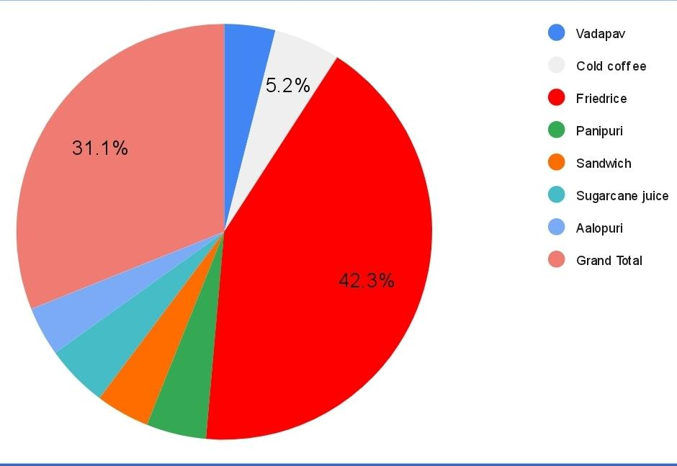
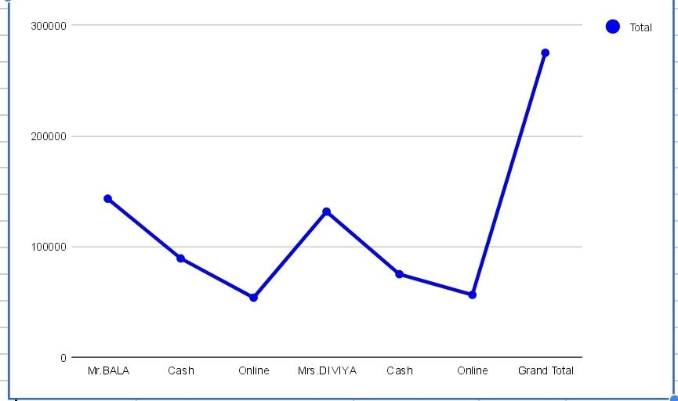
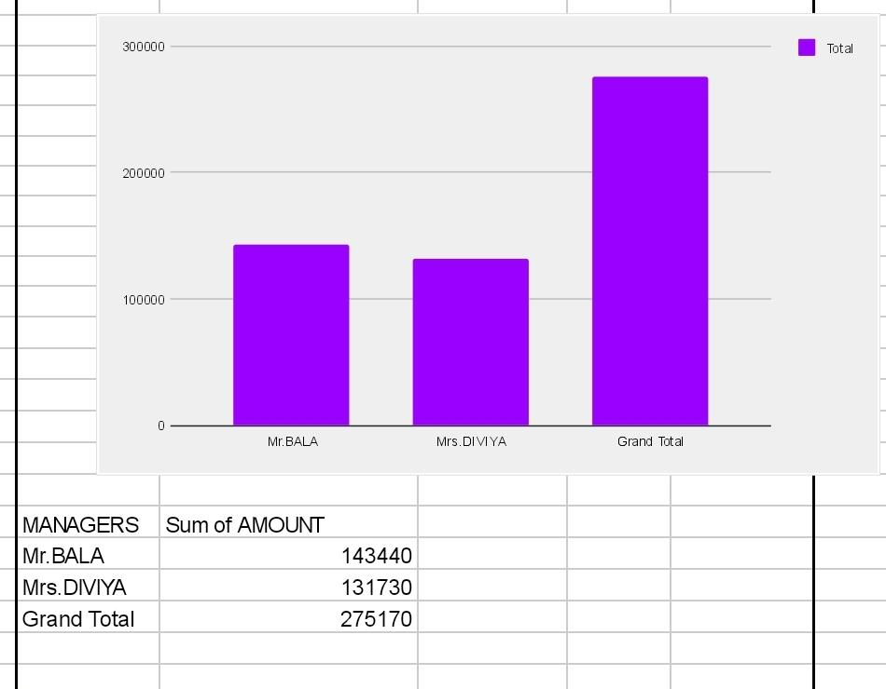
RESULTS :

Slide 14
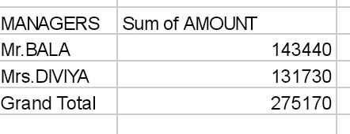
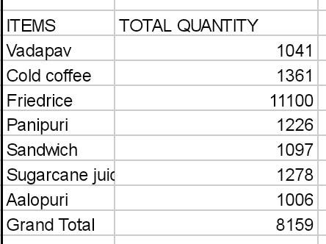
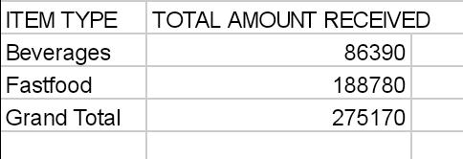
CONCLUSION :
TOTAL SALES DONE BY MANAGERS
MOST SOLED DISHES BY QUANTITY
MOST PROFIT ERANED BY

